Slide 1
Design and Experience of A Large Blockchain Project
Wei-Tek Tsai
Beihang University & Arizona State University

Slide 2
BC Status in China
Government started to pay attention to BC. CAC (Cybserspace Administration of China) and MIIT have study groups, some may deploy BCs soon for non-critical applications.
Almost all major financial institutions are studying BC, including PBoC, Bank of China, UnionPay, AliPay, TenPay, major brokerage houses. But few will deploy it soon.
Multiple consortiums, universities and research laboratories have been set up.
Funds are investing in BC companies overseas.
Like to collaborate with Chinese organizations? Funds are allocated now.

Slide 3
CCTV Project Goals
Scalable real-time tracking of microfilm usage at Internet scale
High throughput and low delay: Support 3.6M concurrent users in Beijing in one hour, expected load will be 10K tps.
Automated dispute resolution and revenue splitting
200 blockchain systems in 5 years. At that time, $10B RMB of money flow per year, about 500M RMB revenue for CCTV per year, or about $70M USD.

Slide 4
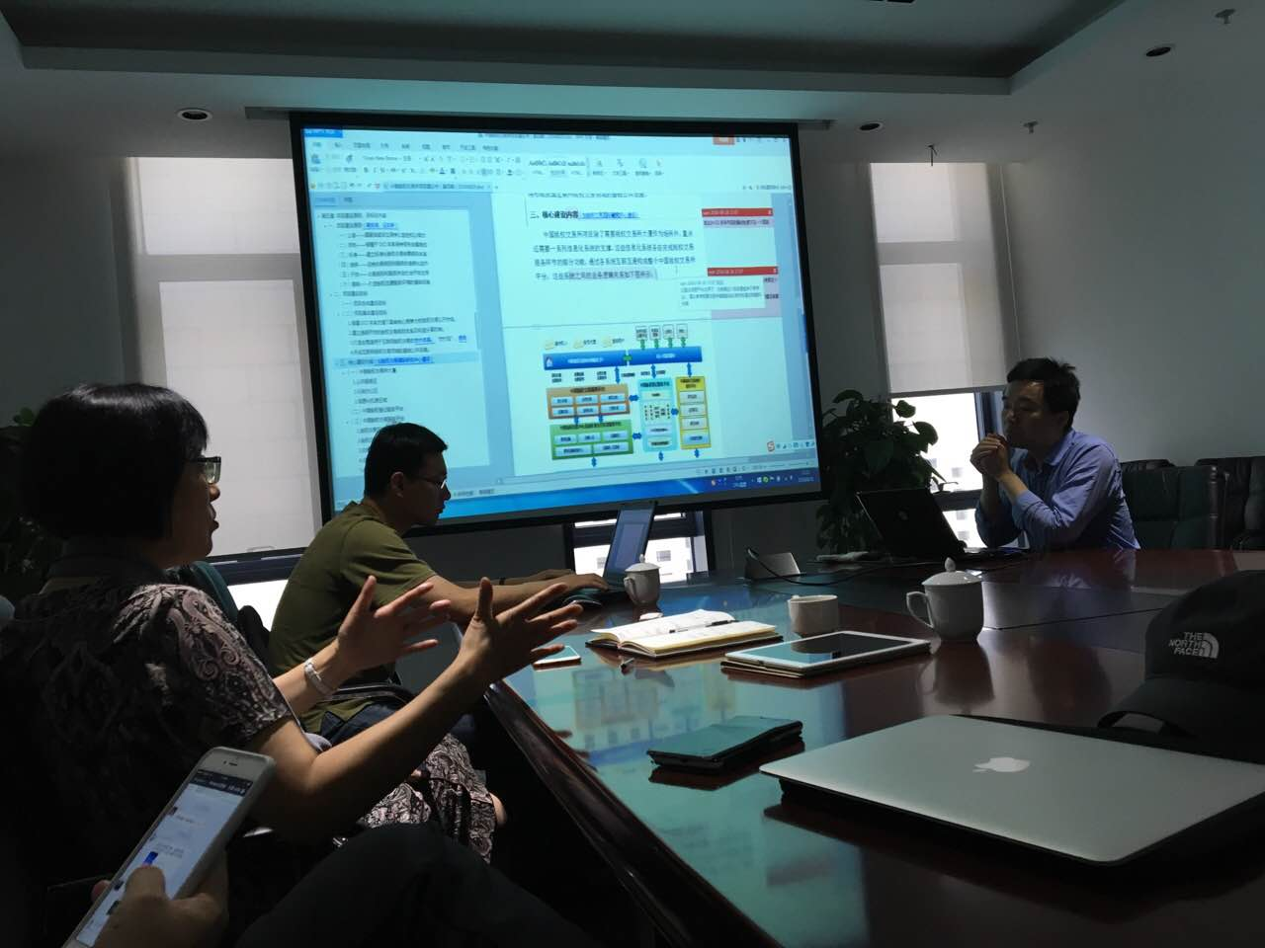
Motivation
Chinese government (3 agencies including National Copyright Protection Center) is pushing for copyright protection,
Current 3rd party system does not provide enough evidence.
Growing 60% per year with significant fund into this area.

Slide 5
Blockchain Definition
Chain of blocks: A chain of blocks, each uses the hash of previous block as a part of current block (complete history).
Multiple independent copies of chains.
Use Byzantine (or 51%) protocols for voting.
Those systems not satisfying these properties are considered as variants.

Slide 6
History
Started developing a permissioned BC in 2015, first prototype ran at 200 transactions per minute in Oct. 2015.
Used PBFT as consensus for a lottery system and it was never changed except we parallized PBFT.
First comparison was with Hydrachain in late 2015, then Hyperledger.
> 50 increments, some increments failed.
Current system handles 18K tps with the original goal at 10K tps. Early prototype reached average 48K tps for a lottery system.

Slide 7
Issues Encountered
Some related to specific systems or technologies used such as databases.
Some related to specific design deployed.
Some related to the consensus protocol used (PBFT).
Some related to BC definitions such as chaincode definition.

Slide 8
Block Creation
As a parallelized PBFT, a block created earlier may complete its voting after a later block. What should we do?
Wait for the earlier block to complete first?
Do not wait for it.
A related issue is if a transaction is not included in a block, what should we do? (put it back to the front of the cache queue?) What if it continues to be voted out? (it may not be a good transaction so eventually it should not be included in any block)

Slide 9
Decisions Made
100% of transactions entered will be recorded without any exceptions. Currently our system performed at 100% even when the system cannont handle the load.
Each node distrusts each other, added a reputation system to detect compromised nodes. Remove compromised nodes immediately and add penalties such as reducing payment.
Allow nodes making mistakes such as dropping messages, variations in handling loads, and messages arriving at different orders. But they cannot send different votes to different nodes.

Slide 10
Computing Power vs Scalable Design
Large amount of computing goes to signature and verifications, as high as 90% in some of earlier systems. Encryption will have additional loads.
To reach the stated goal, we added significant power to each node. But sometimes they did not return good results. The most recent event, we 2x power, but got 30% increase only (expected 3x increase).
Scalable software design is more important.
Database is one critical factor. For example, what should be a good DB design within a node? Append-only?

Slide 11
Scalable Design
Use a database to cache data whenever possible. Never allow any systems to compete on those caches.
Split a BC into 2 BCs if necessary to handle the load.
Each BC handles one kind of activities in a multi-chain environment.
Add more operations but simplify design
But cannot over do as each BC is expensive.

Slide 12
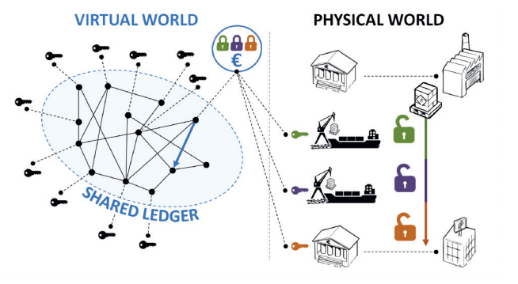
New Blockchain Design
ABC
TBC2
ABC
TBC 1
ABC

Slide 13
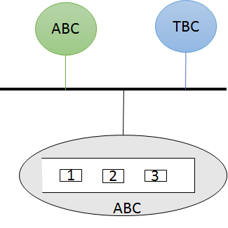
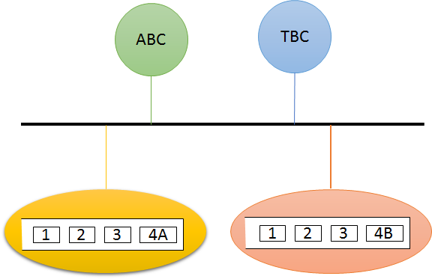
Elastic ABC Blockchains
Loading Balancing

Slide 14
2 BC Designs
ABC (account BC): contains account information, but it will not handle trading.
TBC (trading BC): contains information useful for trading, but it does not contain full account information.
Before trading: account information will be copied from ABCs to appropriate TBC for transactions. Relevant data will be locked.
After trading: account information will be copied from the TBC back to the ABCs.
Locks will released.
Data in the TBC will be labeled “expired”

Slide 15
Chaincode (Smart Contract)
If a BC is slow, there is no problem, the next block can wait.
But in a high-speed BC, should we wait for the running chaincode to complete its execution?
Decisions: no. Some chaincode will have a very long life, i.e., weeks, and we do not know this until it is done. What exactly is chaincode?
Like database triggers, policy specification/execution problem in traditional and service-oriented systems. This is a hard problem in general and no good solutions except making it small.

Slide 16
Database Issues
What are characteristics of the application? More reads or more writes?
How big is each transaction?
Use relational database? KV database? Append-only database?

Slide 17
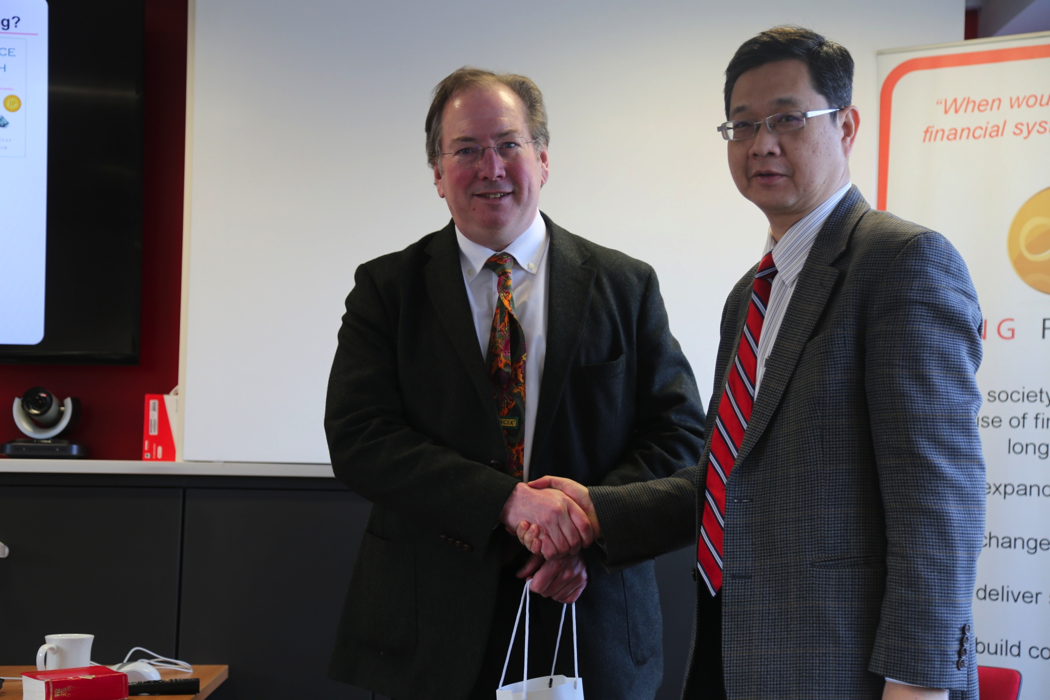
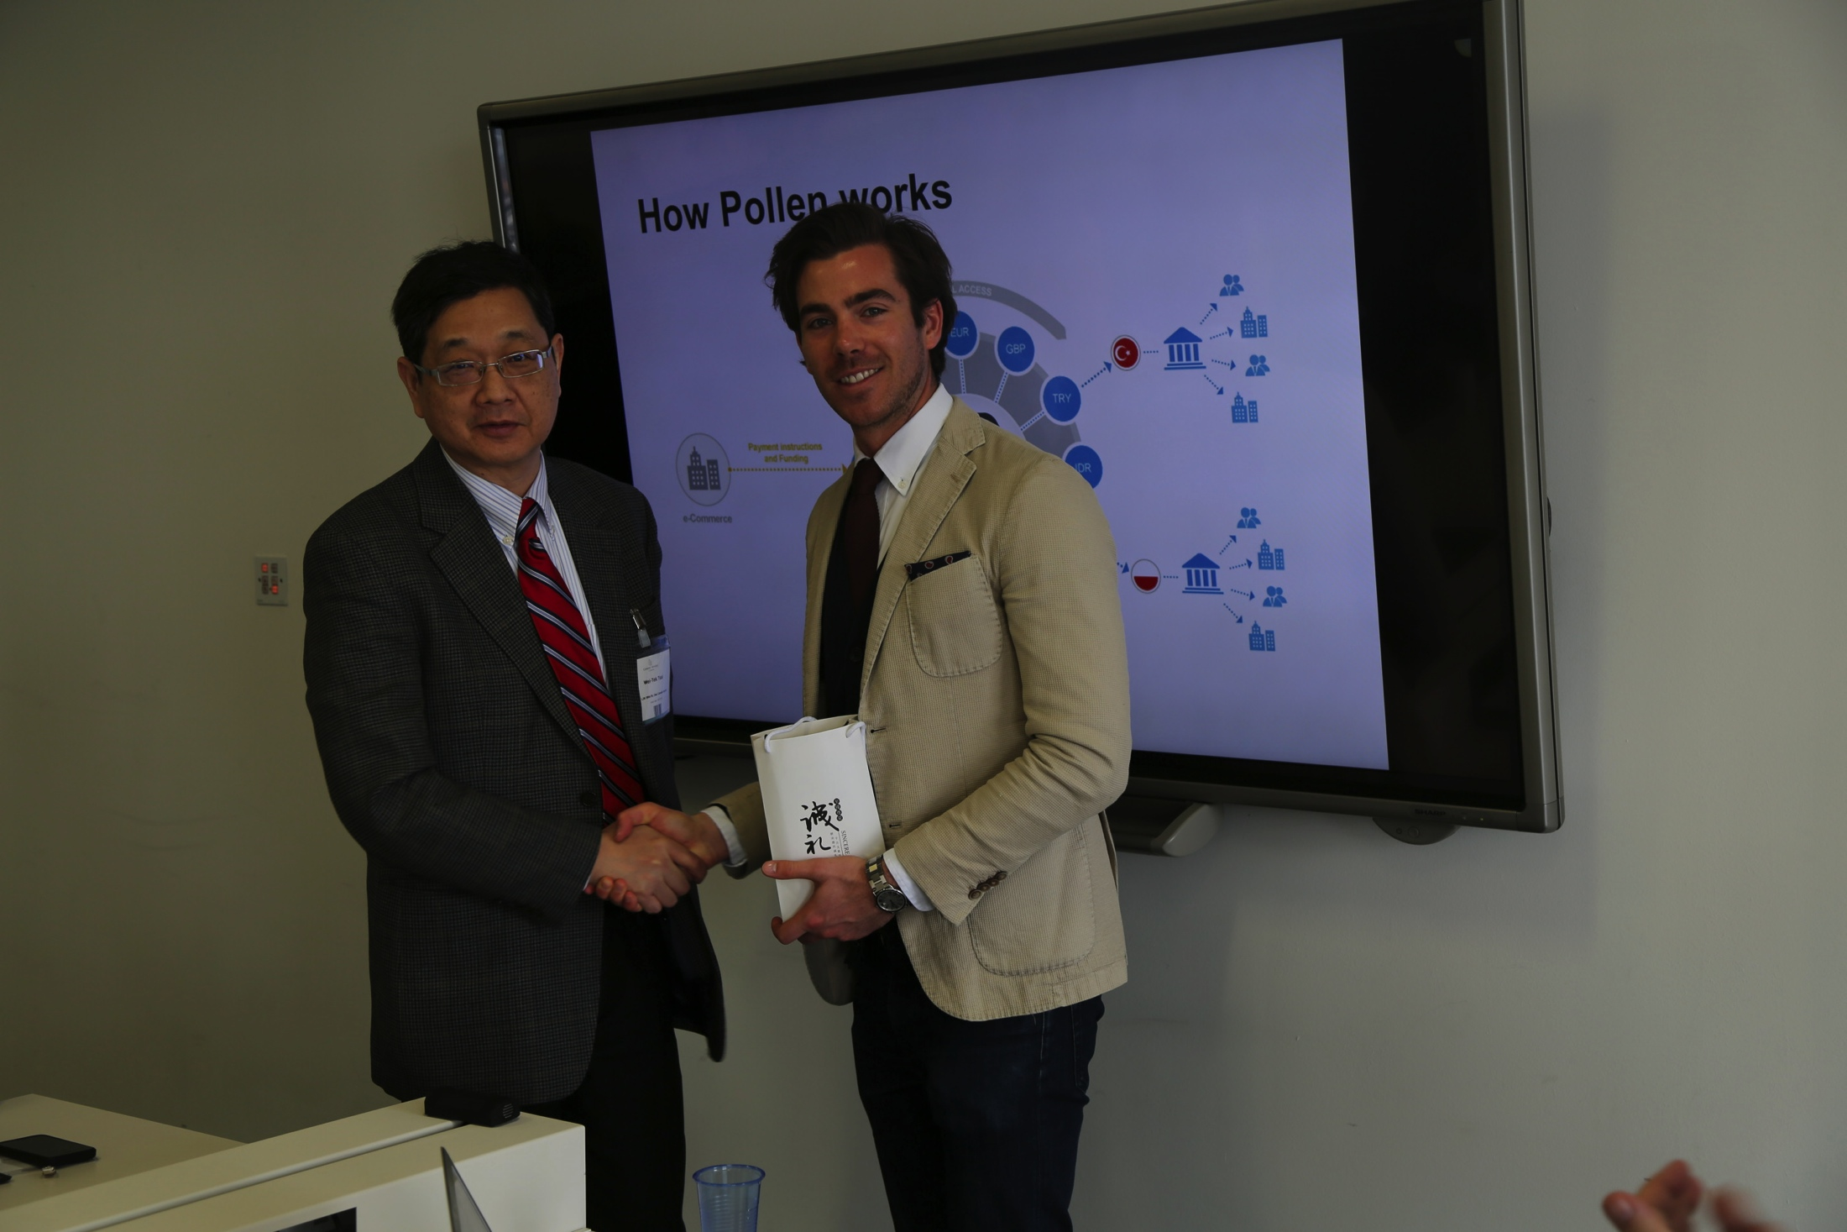
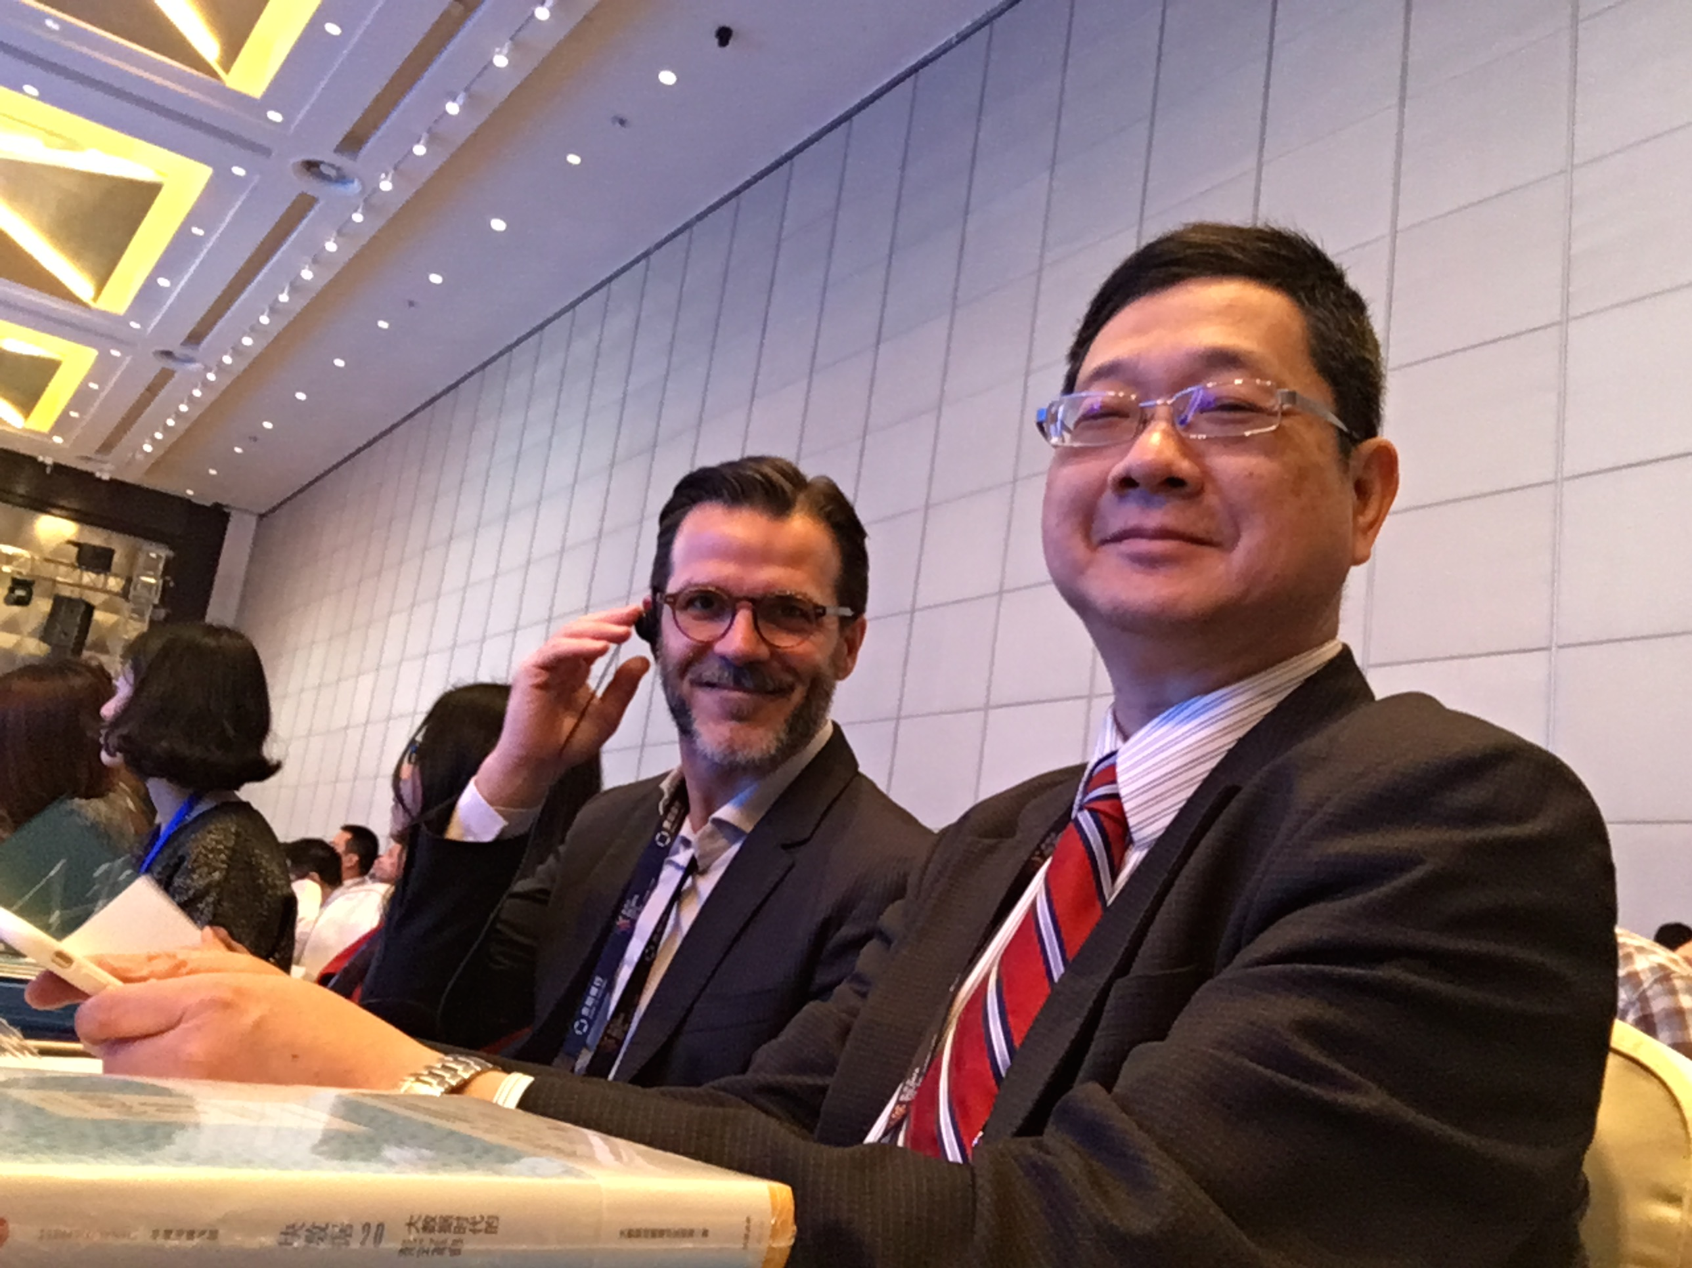
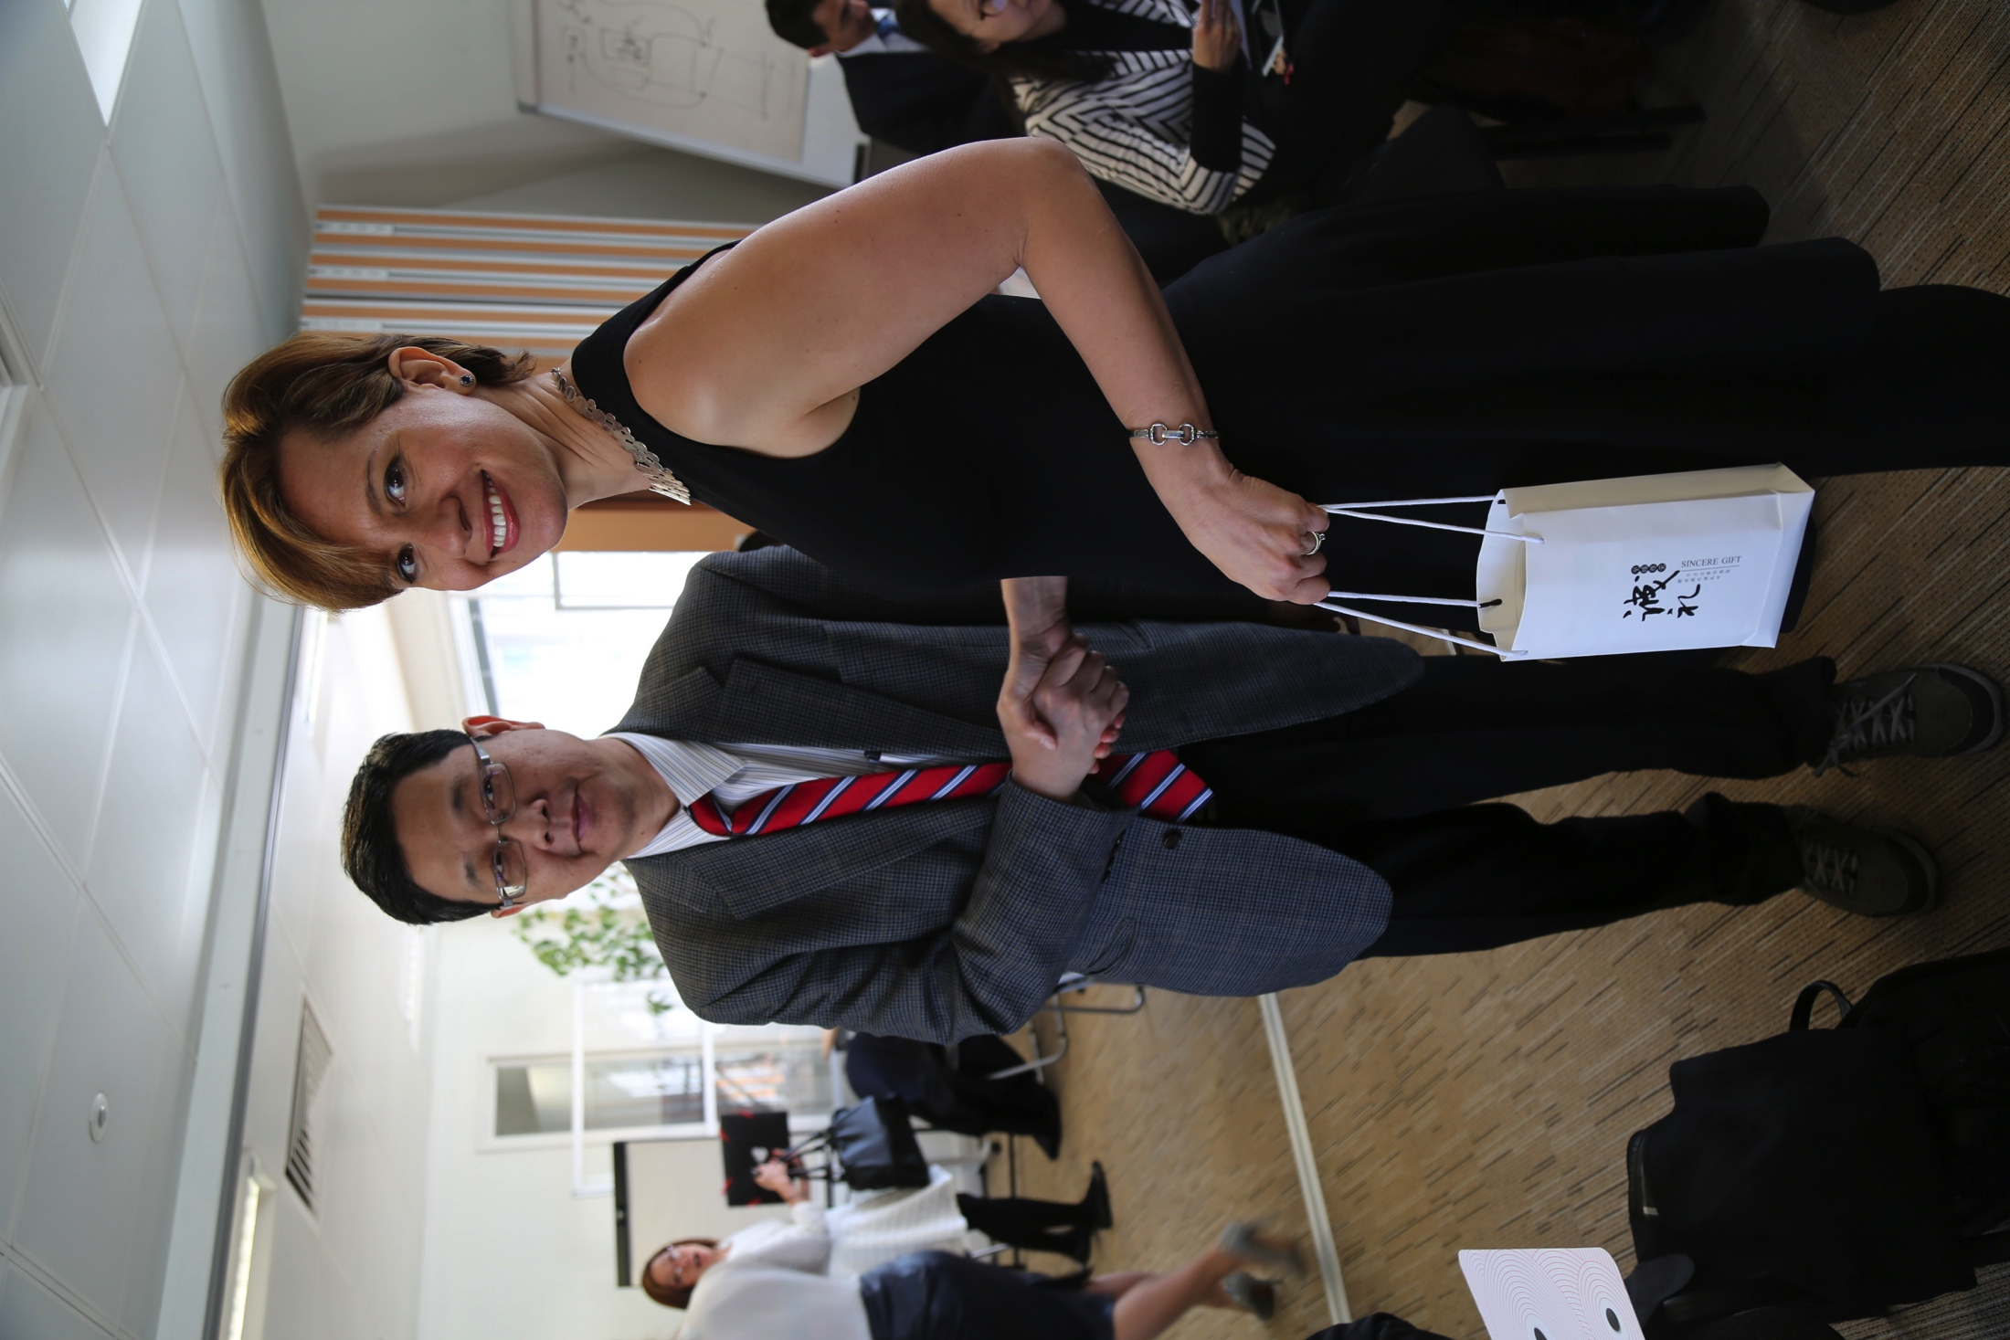
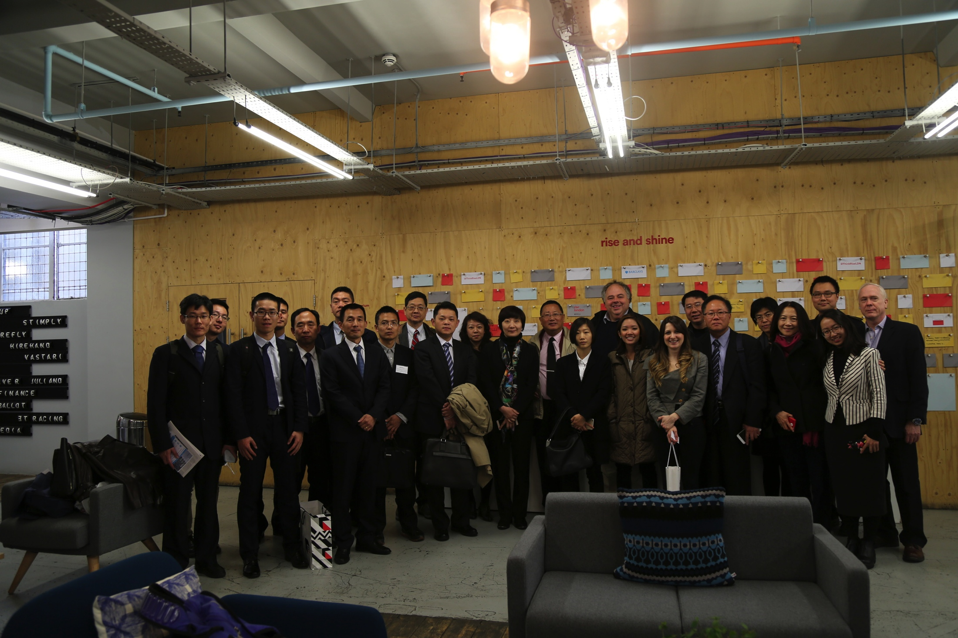
China Seeks Collaboration
Seek multiple projects to collaborate on technical, business, and cultural matters
Beijing Institute of Collaborative Innovation (ICI) with majority of funding from government.

Slide 18
Thank you!

